Slide 1
Space-time trends in temperature extremes in south central Sweden
Peter Guttorp
Norsk Regnesentral
University of Washington

Slide 2
Acknowledgements
Joint work with Peter Craigmile, The Ohio State University
Data from Swedish Meteorological and Hydrological Institute
Partial support from National Science Foundation

Slide 3
Outline
Data analysis
Marginal fits
Spatial model
Model assessment

Slide 4
IPCC model results (AR4 WG1 Ch.11)
Fewer frost days
VL (consistent across model projections)
Decrease in number of days with below-freezing temperatures everywhere
Fewer cold outbreaks; fewer, shorter, less intense cold spells / cold extremes in winter
VL (consistent across model projections)
Northern Europe, South Asia, East Asia
L (consistent with warmer mean temperatures)
Most other regions
Reduced diurnal temperature range
L (consistent across model projections)
Over most continental regions, night temperatures increase faster than day temperatures

Slide 5
Data set
Synoptic stations in south central Sweden with 48 years of data

Slide 6
Annual minimum temperatures and rough trends

Slide 7
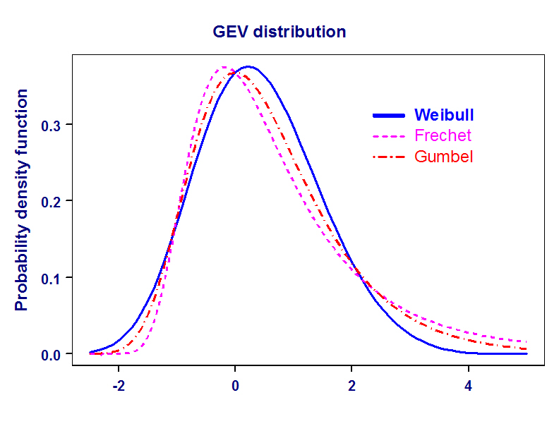
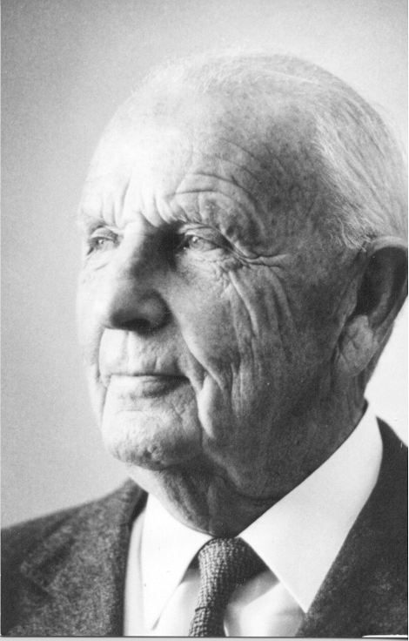
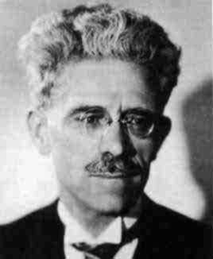
GEV model

Slide 8
GEV fits
Running estimate of 29 years for Sveg
Suggests linear fit for

Slide 9
Location trends

Slide 10
Location slope vs latitude

Slide 11
Dependence between stations
 | Sveg | Malung | Karlstad
Sundsvall | 19 | 12 | 13
Sveg |  | 25 | 11
Malung |  |  | 10
Common coldest day in 48 years
5 common to all 4 northern stations

Slide 12
Spatial model
where
Allows borrowing estimation strength from other sites
Can include more sites in analysis

Slide 13
Full network

Slide 14
Trend estimates
Posterior probability of slope ≤ 0 is very small everywhere

Slide 15
Spatial structure of parameters

Slide 16
Location slope vs latitude

Slide 17
Prediction Borlänge

Slide 19
Notes:
max dist is about 9

